Slide 1


Clinical Update Controversial Thoughts
Taeho Oh, MS, RPh
Leading Change

Slide 2

Blue Zones by Dan Buettner - secrets of longevity and well-being
Ikaria Greece, Okinawa Japan, Sardinia Italy, Nicoya Peninsula Costa Rica, Loma Linda CA USA
Why Are These Zones Special?
  Healthy Diet: Diets are largely plant-based, with whole, unprocessed foods. Limited consumption of meat and sugar. Rich in antioxidants, fiber, and essential nutrients.
Physical Activity: Daily physical activity is integrated into life through walking, gardening, or manual labor.
Strong Social Connections: A focus on family, community, and social networks helps reduce stress and increase happiness.
Stress Reduction: Practices such as meditation, prayer, or afternoon naps are common.
Purpose in Life: A sense of purpose ("ikigai" in Okinawa or "plan de vida" in Nicoya) contributes to mental well-being and longevity.
Moderate Caloric Intake: In Okinawa, for example, the principle of "hara hachi bu" encourages eating until 80% full, avoiding overeating.
Alcohol in Moderation: Moderate consumption of red wine, such as in Sardinia, is linked to cardiovascular health.
Rural area and moderate caloric intake and low animal proteins

Slide 3
Things that make your health worse
Excess weight - increase cancer, heart disease, diabetes, sleep apnea, and more
Bad Diet, increased processed foods, fast foods, foods in high fructose
Sedentary lifestyle and lack of physical activity
Social Isolation and Loneliness
Chronic stress
Smoking
Excessive Alcohol Consumption
Poor sleep
Environmental Exposures of pollutants, allergens, toxins, Not sure where micro-plastics fit in but can’t be good
Non-Adherence to Treatment Plans
Comorbidities
Substance Abuse
Ignoring Early Symptoms, harder to treat late-stage cancer, diabetes, infections and autoimmune diseases

Slide 4
USA is in love with drugs 2023 data
World drug sales $1.6 trillion dollars population 8.09 billion
USA drugs sales $722 billion (45%) US represents 4.3% of the world population 335mm
Japan drug sales $76 billion (4.8%) population 124mm (1.5%)
Germany drug sales $98 billion (6.1%) population 85mm (1.1%)
England drug sales $11 billion (0.7%) population 58mm (0.71%)
These 4 countries population 602mm (7.5%), drug cost $907billion (57%)
Rest of the world population 7.488 Billion (93%) spends $693 billion (43%) for drugs

Slide 5
Reasons for Overuse of High-Cost Drugs
Marketing Influence: Pharmaceutical companies promote high-cost drugs, leading to their preference over generics or older alternatives.
Lack of Cost Transparency: Providers and patients may be unaware of the costs of prescribed drugs.
Patient Demand: Patients may request branded medications due to advertising or perceived superiority and copay cards.
Fragmented Healthcare: Poor coordination among providers can result in redundant or inappropriate prescriptions.
Clinical Guidelines Favoring New Drugs and innovation: Guidelines sometimes promote newer, expensive drugs based on limited comparative evidence. Supported by Pharma.

Slide 6
DTC advertising and Doctors are paid to prescribe certain drugs
In 2022 AbbVie spent $426 mm on Rinvoq DTC
In 2023 Novo Nordisk spent $191mm on Rybelsus DTC
In 2022 Sanofi/Regeneron spent $490 mm on Dupixent DTC
https://openpaymentsdata.cms.gov/
Companies paid $12.75 billion to medical providers in 2023
Payments - free meals, speaking fees and consulting work, affect doctors’ prescription decisions, leading to increased use of companies’ drugs and devices
AbbVie gave $187 mm to prescribers – Humira, Rinvoq and Skyrizi

Slide 7
Formulary Games
Some formularies have brand at lower tier than generic alternatives: Examples
  Eliquis (#1, $7.28B) and Xarelto (#3, $4.03B) Tier 3 and dabigatran Tier 4
    Missed savings of several Billions
  Advair HFA and Advair Diskus (#14, $1.71B)
    Generics are non-Formulary or higher tier
  Diabetic agents
    Jardiance and Farxiga and no Dapagliflozin or Steglatro
    Januvia and Tradjenta and no saxagliptin (DPP4 have poor efficacy)
    Basaglar and Fiasp and no insulin glargine or insulin aspart
  Vascepa
    Icosapent not covered or higher tier
  Restasis UDV and Multidose
    Cyclosporin UDV not covered or higher tier

Slide 8
Examples of unnecessary treatments or
doesn’t improve outcomes
Strensiq $1.6-2.4mm/year for adult onset hypophosphatasia
Sucraid ($118k/yr) for bloating, excessive gas production, diarrhea and abdominal pain without CSID
Antibiotics for viral infections like common colds, runny and stuffy nose, fever and chills
Opioids for chronic back pain or arthritis
Vitamins - supplements like vitamin D, calcium, or multivitamins without documented deficiencies or evidence of benefit
Hormone Replacement Therapy (HRT) - Prolonged or unnecessary use of HRT in postmenopausal women without clear indication.
Growth Hormone $100k/yr for idiopathic short statue
Acthar gel $2mm/yr for MS and Cushing syndrome
Olumiant ($34k/yr)and Litfulo (53k/yr) for Alopecia Araneta (autoimmune, cosmetic)
Opzelura ($26k/yr) for Nonsegmental vitiligo (cosmetic)
Emflaza $80-120mm/yr for Duchenne muscular dystrophy, use prednisone for $240/year
Overuse of new agents in diabetes, long-term use of PPIs
Notes:
Congenital Sucrase-Isomaltase Deficiency (CSID)

Slide 9
Examples of overuse of expensive drugs
Biologic Drugs for Inflammatory Diseases:
  Drugs: Adalimumab (Humira), Infliximab (Remicade), Etanercept (Enbrel) and more.
  Issue: Often prescribed for conditions like rheumatoid arthritis, psoriasis, or inflammatory bowel disease without exhausting less expensive first-line treatments.
  Cost: Thousands of dollars per month.
  Alternative: Methotrexate, sulfasalazine, or other conventional therapies when appropriate.
Expensive Cancer Drugs:
  Drugs: Bevacizumab (Avastin), Pembrolizumab (Keytruda), Nivolumab (Opdivo).
  Issue: Prescribed in late-stage cancers with limited evidence of significant benefit in terms of survival or quality of life.
  Cost: Tens of thousands of dollars per course.
  Alternative: Palliative care or less expensive regimens when appropriate.

Slide 10
Examples of overuse of expensive drugs
Specialty Drugs for Hepatitis C:
  Drugs: Sofosbuvir (Sovaldi), Ledipasvir-Sofosbuvir (Harvoni).
  Issue: Prescribed in situations where immediate treatment might not be necessary (e.g., stable cases with minimal liver damage).
  Cost: Up to $90,000 for a treatment course.
  Alternative: Strategic timing of treatment based on disease progression.
Overuse of Erythropoiesis-Stimulating Agents (ESAs):
  Drugs: Epoetin alfa (Epogen), Darbepoetin alfa (Aranesp).
  Issue: Used in anemia management beyond evidence-supported thresholds.
  Cost: Hundreds to thousands of dollars per dose.
  Alternative: Conservative anemia management strategies or iron supplementation.

Slide 11
Examples of overuse of expensive drugs
Expensive Cholesterol-Lowering Drugs:
  Drugs: PCSK9 inhibitors (e.g., Alirocumab, Evolocumab).
  Issue: Used in patients with mild cholesterol issues who do not meet strict criteria for use.
  Cost: Over $14,000 per year.
  Alternative: Statins or lifestyle changes for many patients.
Expensive Antipsychotic Medications:
  Drugs: Long-acting injectables like Risperdal Consta, Abilify Maintena.
  Issue: Used in mild cases of mental illness or off-label when less expensive oral options could suffice.
  Cost: Thousands of dollars annually.
  Alternative: Generic oral antipsychotics when appropriate.
Overuse of Newer Diabetes Medications:
  Drugs: SGLT2 inhibitors (e.g., Canagliflozin, Empagliflozin), GLP-1 agonists (e.g., Semaglutide, Dulaglutide).
  Issue: Used as first-line treatments instead of less costly metformin or sulfonylureas.
  Cost: Hundreds to thousands of dollars per month.
  Alternative: First-line use of metformin or lifestyle interventions.

Slide 12
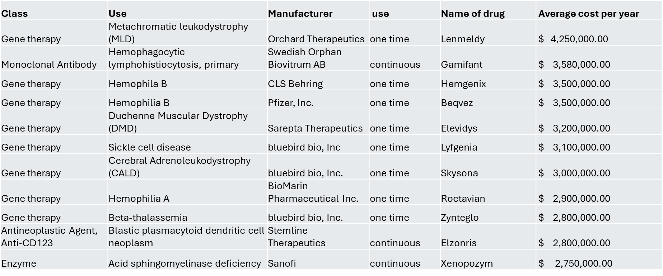
Highest Cost Therapies

Slide 13
How do we manage these super expensive therapies – Criteria so important
Develop Clear Medical Necessity Criteria
  Approved indications
  Patient eligibility criteria (genetic confirmation of diagnosis, disease severity, and stage).
  Exclusions based on contraindications or risks.
Pre-Authorization Requirements
  Require documentation of diagnosis, genetic test results, and clinical history.
  Verify that alternative treatments have been considered or tried.
Multidisciplinary Care Team - involve specialist, Pharmacists, Pharmacy and Therapeutics Committee
Monitor Outcomes and Follow-Up
  Track treatment outcomes and Monitor long-term efficacy and safety.
  Require regular follow-ups to assess disease progression or remission.
Patient Education and Support (by prescriber)
  Discuss risks, benefits, and realistic expectations and commitment required
US-Rx Care is fighting the tide, Pharma, Guidelines funding, DTC, MD economics, other PBM

Slide 14
Coverage determination -Perspectives
Prescriber Perception
  Negative
  Blocking the patient and doctors from getting proper treatment
  Wearing out the doctors and patients
  Doctors – “nightmare PA buried in paperwork”
Payor Perception
  Positive, need cost controls and prevent unnecessary treatment
  Ensure the most cost-effective treatment in a step wise fashion
  Prescribers getting economic benefit to prescribe new medications
Pharma Perception
  Block access to cutting edge treatment and needed treatment
  No reason to use the older generic medications
Patient Perception
  Block access to good care
  Get generic specialty and pay obscene copay, Brands have copay cards

Slide 15
Doctors complain that PA are to prevent approval and give MD a hard time
Case; LL is 61-year-old female diagnosed with Psoriasis and Psoriatic arthritis. LL’s physician prescribed Taltz. Per appeal letter, patient was treated with various biologic medication such as Humira, Cosentyx, Stelara, and Rinvoq, but there was no record to prove it. Physician wanted to prescribe only Taltz. We have confirmed facts that this physician has received payment from pharmaceutical company which makes Taltz by searching in Openpayment.
Dermatologist get paid the most by Pharma to prescribe their drug
Prescribers with the help of Pharma start on samples – now consider continuity of care and pins the members against the PA process. Copay cards for brands but not for generics.
That is why we ask doctors for medical records and the information needed to make proper determination
We cannot take it lightly for drugs that cost $50,000 to $2 mm per year
When we do P2P we tell the prescriber what the drugs cost and the cost of the alternatives. The oncologists are the most reasonable. The allergists and dermatologists are the most difficult to deal with.

Slide 16
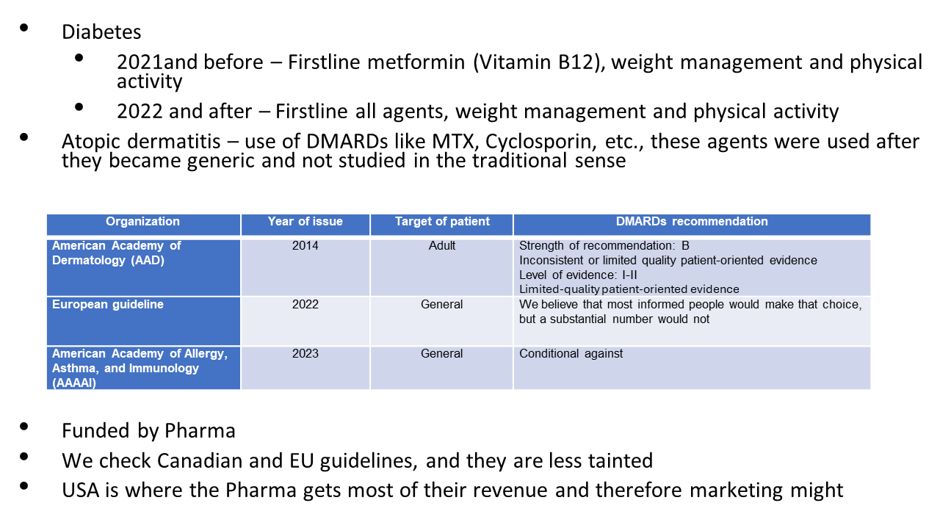
Guidelines are tainted

Slide 17
Autoimmune Diseases – most common
rheumatoid arthritis, Ankylosing Spondylitis, Juvenile Idiopathic Arthritis, uveitis
psoriasis, psoriatic arthritis,
type 1 diabetes,
inflammatory bowel disease (IBD),
Crohn’s disease,
celiac disease,
multiple sclerosis
Systemic lupus erythematosus

Slide 18
Immunosuppressant for autoimmune disease
DMARDs – methotrexate, Cyclosporine, azathioprine, hydroxychloroquine, sulfasalazine, leflunomide, cyclophosphamide,
Glucocorticosteroid – prednisone
Targeted biological DMARDs
  Dupixent – interleukin-4 receptor antagonist
  Humira – Anti-TNF alpha blocker
  Stelara – IL 12 & 23 inhibitor
  Skyrizi – IL 23 inhibitor
  Ilumya – IL 23 inhibitor
  Taltz – IL 17A inhibitor
  Xeljanz – Janus Kinase Inhibitor

Slide 19
Treatment without drugs
Autoimmune diseases and are you sensitive. Most people are not.
What is the cause and the triggers that exacerbates your disease
  Dairy from A1 beta casein protein – all milk. A2 beta casein milk are labeled A2
  Some drugs – sulfa containing drugs
  Processed vegetable oils
  Some nuts like cashew and seeds
  Food additives added sugars, artificial sweeteners, and preservatives
  Alcohol
  Legumes –beans, lentils, peanuts, peanut butter, soy products
  Grains –wheat, barley, oats, rice, quinoa, corn and processed grain products
  Some veg – tomatoes' skin & seed, eggplants, peppers, squashes raw or with seeds & skin
Remove lectins (proteins) - Pressure cooking, peeling & removing seeds, fermentation
How can your treat without drugs – find and avoid your triggers

Slide 20
Success stories without medication
June O - psoriatic arthritis – decrease drug to removal by removing land animal proteins
Yvonne K – lupus, immunosuppressant with continued symptoms, stopped after eating only organic chicken (removal of corn and soybeans )
Jill W – Crohn's, avoided grains, wheat, barley, oats the foods that caused her symptoms.
Individualized, start removing high trigger foods
Good Foods - Whole foods, not processed foods, fresh foods, fermented foods, olive, coconut, avocado oils, vinegars, honey, maple syrup, green and black tea, tubers – yams, sweet potatoes, taro, artichokes, green plantains, yucca

Slide 21
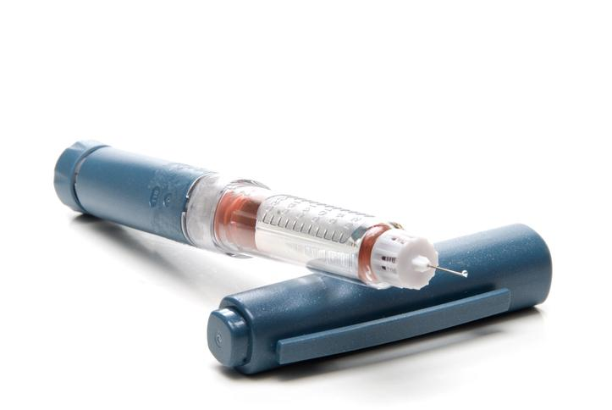
Diabetes Statistics
Over 35 million Americans (over 10% of the population) have diabetes
  1.5 million have type 1
  Approximately 1 million new cases annually through 2030
85 million Americans have prediabetes
25% of US diabetics use insulin
                100% of Type 1 diabetics
                21% of Type 2 diabetics
More common in Native American and non-Hispanic black populations
Four major manufacturers of insulins in the US
Eli Lilly
Novo Nordisk
Sanofi
Biocon

Slide 22

Obesity Stats
Adult population
40% obese (8% severely obese)
32% overweight
Child and Adolescent Population
19% obese (6% severely obese)
17% overweight
Influence of Race
Black and Hispanic women
Hispanic men, in the South and Midwest and in nonmetropolitan counties
Tends to increase with age.

Slide 23
Comparison of Anti-Diabetic Agents
A Deep Dive (post-2024 price) changes)
Category | Brand | Generic | PI - HbAIc Reduction | WAC Cost/mo. | Cost of lower HbA1c x 1
Biguanide | Metformin | Metformin | 1-2 | $10 | $5
Sulfonylurea | Glucotrol | Glipizide | 1-2 | $10 | $5
Thiazolidinedione | Actos | Pioglitazone | 1 | $10 | $10
dpp4 | Januvia | Sitagliptin | 0.5-0.8 | $330 | $413
dpp4 | Tradjenta | Linagliptin | 0.4 | $525 | $1,313
glp1 | Bydureon | Exenatide | 1.6 | $828 | $518
glp1 | Byetta | Exenatide | 0.7-0.9 | $850 | $944
glp1 | Mounjaro | Tirzepatide | 1.6 (2.3) | $1,080 | $675
glp1 | Ozempic | Semaglutide | 1.4-1.6 | $998 | $624
glp1 | Trulicity | Dulaglutide | 0.7-0.8 | $987 | $1,234
glp1 | Generic | Liraglutide | 1.0 | $360 | $360
sglt2 | Jardiance | Empagliflozin | 0.7-0.8 | $630 | $788
sglt2 | Invokana | Canagliflozin | 0.91 | $599 | $658
Note: dollars are pre-rebate
Notes:
HbA1c Reduction with Mounjaro:
SURPASS-1 Trial: In this 40-week study involving patients with type 2 diabetes inadequately controlled with diet and exercise, Mounjaro was administered as monotherapy. The results showed significant reductions in HbA1c levels:
5 mg dose: average reduction of 1.87%
10 mg dose: average reduction of 1.89%
15 mg dose: average reduction of 2.07%
These reductions were significantly greater compared to placebo. MedLibrary.org
SURPASS-2 Trial: This 40-week study compared Mounjaro to semaglutide (1 mg) in patients with type 2 diabetes inadequately controlled with metformin. The findings indicated:
5 mg dose: average HbA1c reduction of 2.01%
10 mg dose: average reduction of 2.24%
15 mg dose: average reduction of 2.30%
All doses of Mounjaro resulted in greater HbA1c reductions compared to semaglutide.

Slide 24
GLP1 Utilization Highlights
GLP-1s have become the best-selling drug class in 2024, with annual sales of nearly $40 billion
By 2030, annual sales are projected to exceed $120 billion
The number of people taking GLP-1s in the US is expected to reach 30 million by 2030, which is about 9% of the population
The US Inflation Reduction Act may lead to price negotiations for popular GLP-1s, which could result in a general price decrease

Slide 25
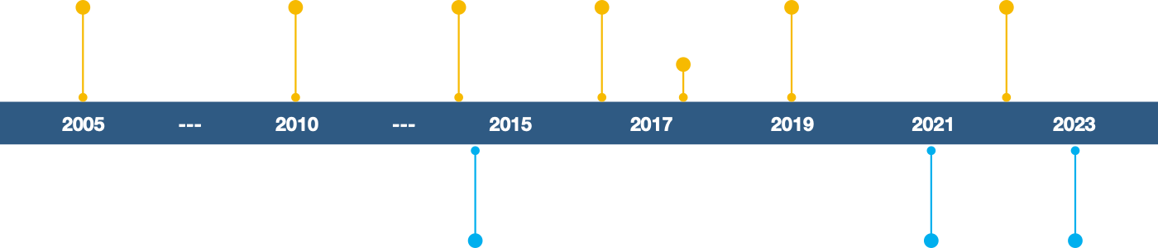
Timeline of GLP-1
Agonist Approvals
Indicated for Type 2 Diabetes
Byetta
exenatide
Victoza
Iiraglutide
Trulicity
dulaglutide
Ozempic
semaglutide
Rybelsus
semaglutide
Mounjaro
tirzepatide
Bydureon BCise
exenatide er
Saxenda
liraglutide
Wegovy
semaglutied
Zepbound
tirzepatide
Indicated for Chronic Weight Management

Slide 26
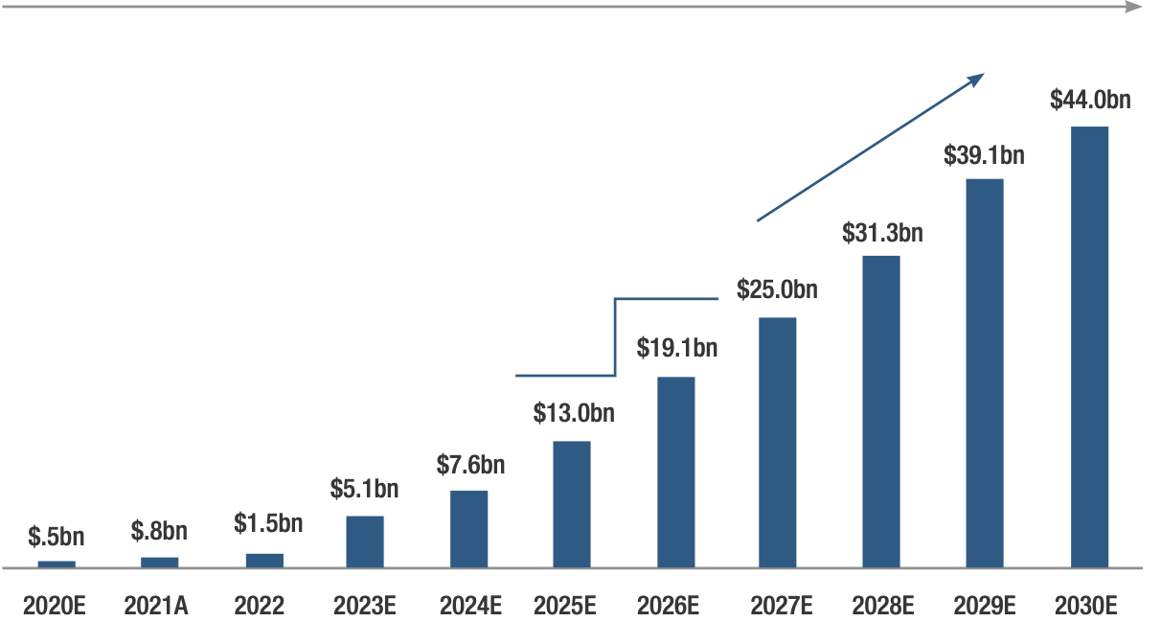
The U.S. obesity market is expanding rapidly
53% CAGR 2022-2030
Includes commercial penetration and
Start of Medicare coverage
Inflection in commercial coverage and
Significant mfg capacity expansion
Source: JP Morgan

Slide 27
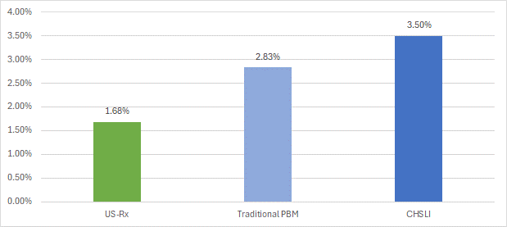
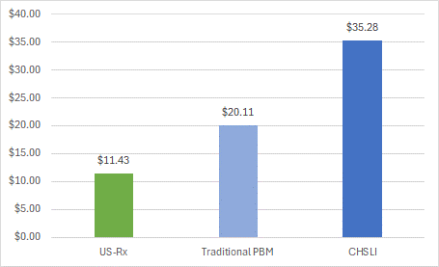
GLP1 Utilization Comparison
Traditional PBM member utilization and cost is trending over 70% higher than
US-Rx Care client experience for the same date range.
Percent of Members on a GLP1
Pharmacy Charges Per Member Per Month*
Optum
Client
Optum
Client
* Pharmacy Charges = Ingredient Cost
Members include primary insured individuals plus dependents
Source: Employer claims history, September 2023 through February 2024

Slide 28
Weight Loss Management
Change Lifestyle and Habits Avoid sugary drinks. Adopt the right diet – avoid processed and junk foods, eat green vegetables, Mediterranean diet is a great option. Meal prep-once a week. Intermittent fasting also works (eat only lunch and dinner). Get active - take daily walks, swim, play sports, take fitness classes, do yoga or Pilates, and use weights at a gym. Sleep 7-9 hours daily. | Education, advocacy, case management, diet programs
Appropriate Use of Medications Generics/OTCs Glucagon-like peptide-1 (GLP-1) receptor agonists - Victoza/Saxenda (liraglutide) daily injection, $816 / $1,349 - Ozempic/Rybelsus/Wegovy (semaglutide), $969 / $1,349 - Mounjaro/Zepbound (tirzepatide), $1,069 / $1,059 (price increases with dose increases) Side effects: nausea, vomiting, diarrhea, pancreatitis, acute kidney injury, worsening diabetes-related retinopathy, tachycardia, headaches, indigestion, gastroparesis, bowel obstruction, or ileus | Restricted to most needy; medical necessity BMI Comorbidities FDA Guidelines
Role of Surgical Interventions Last Resort: gastric balloon, endoscopic sleeve gastroplasty procedure (accordion procedure), inject botulinum toxin in stomach walls. | Outcomes? Cost?

Slide 29
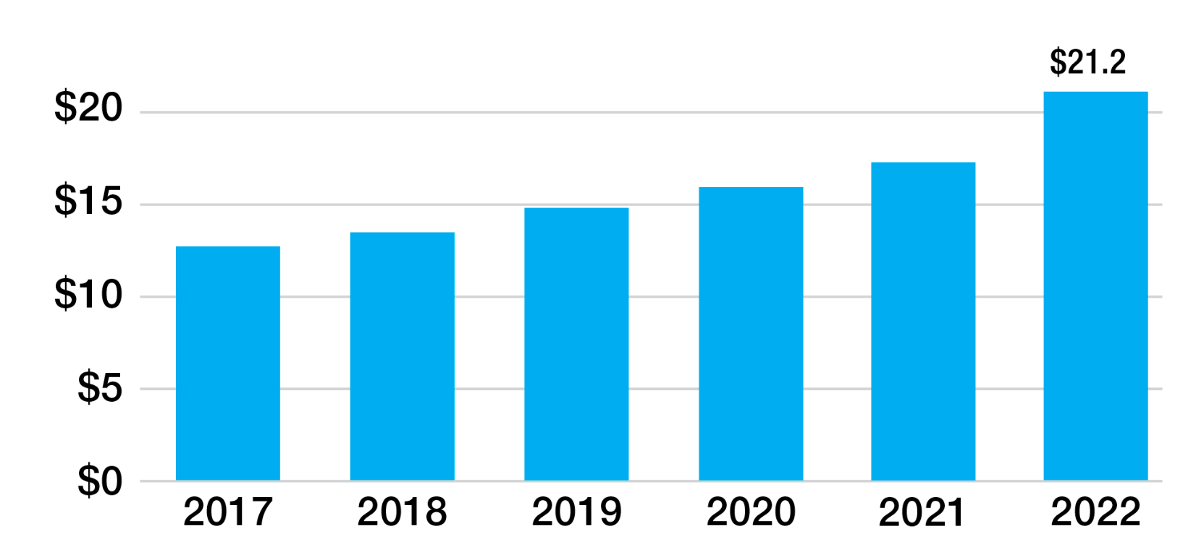
Unprecedented Market Success
USA Revenue for Humira, in Billions USD
(2017-2021)
Abbvie estimates a 37% drop in Humira sales in 2023 and again in 2024
Source: Abbvie
Source: Abbvie

Slide 30
Biosimilar Humira Example
(40mg dose)
^{DOSAGE} | ^{NDC} | ^{GPI} | ^{Humira and Biosimilars} | ^{WAC}
40 | 61314032720 | 6627001504D515 | Adalimumab-adaz SOAJ 40MG/0.4ML | $1,315
40 | 49502041802 | 6627001535F820 | Adalimumab-fkjp PSKT 40MG/0.8ML | $995
40 | 55513040001 | 6627001510D520 | Amjevita SOAJ 40MG/0.4ML | $1,385
40 | 597037597 | 6627001505F520 | CyltezoAJKT 40MG/0.4ML | $6,576
40 | 78206018601 | 6627001520E510 | Hadlima SOSY 40MG/0.4ML | $1,038
40 | 49502038002 | 6627001535F520 | Hulio AJKT 40MG/0.4ML | $6,576
40 | '00074055402 | '6627001500F430 | Humira Pen PNKT 40MG/0.4ML | $6,923
40 | 61314047320 | 6627001504D515 | Hyrimoz SOAJ 40MG/0.4ML | $6,577
40 | 65219055408 | 6627001502F540 | Idacio AJKT 40MG/0.8ML | $6,577
40 | 72606003009 | 6627001503F530 | Yuflyma AJKT 40MG/0.4ML | $6,576
40 | 70114022002 | 6627001509D240 | Yusimry SOPN 40MG/0.8ML | $995
40 | 51759040202 | 6627001540F520 | Simlandi INJ 40MG/0.4ML | $1,038
40 | `00069032502 | 6627001507F520 | Abrilada PEN 40MG/0.8ML | $6,576

Slide 31
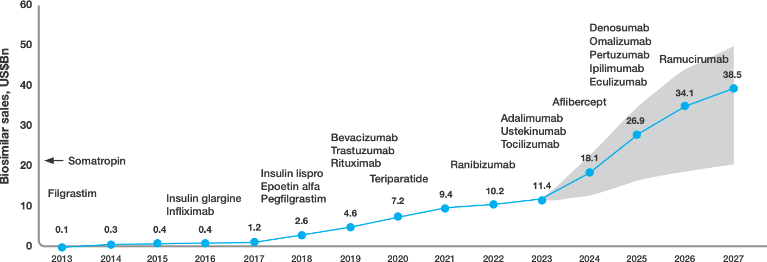
Biosimilars Gaining Ground
Source: IQVIA
Source: IQVIA

Slide 32
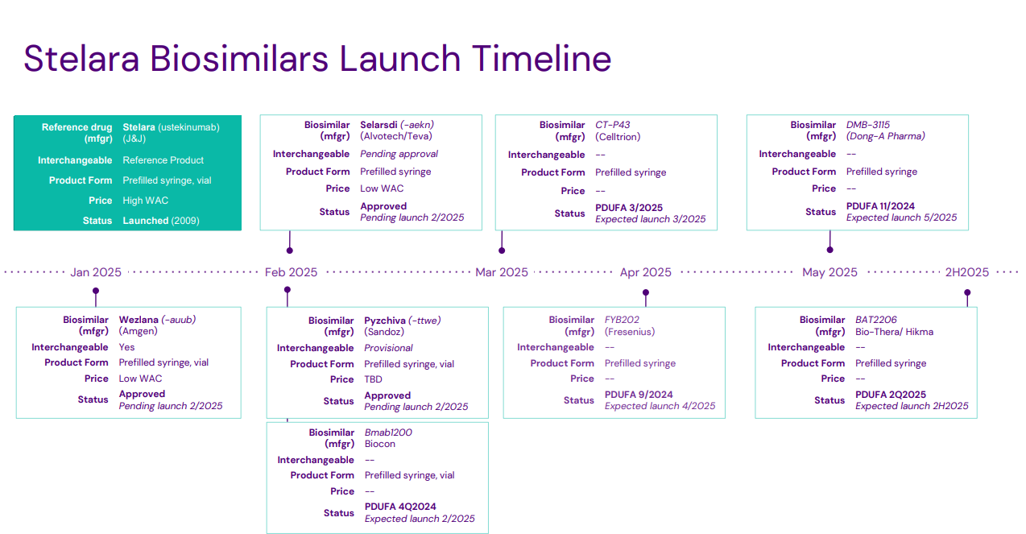

Slide 33
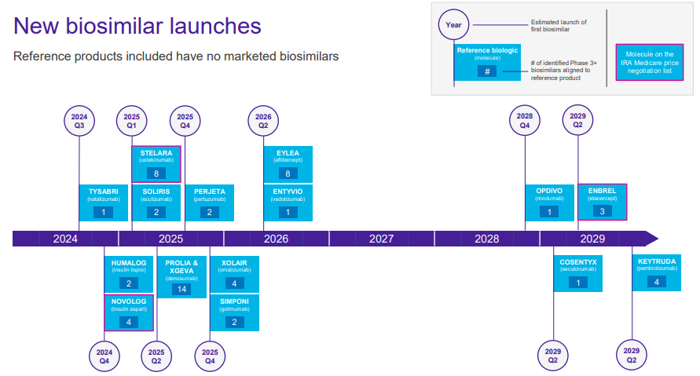

Slide 34
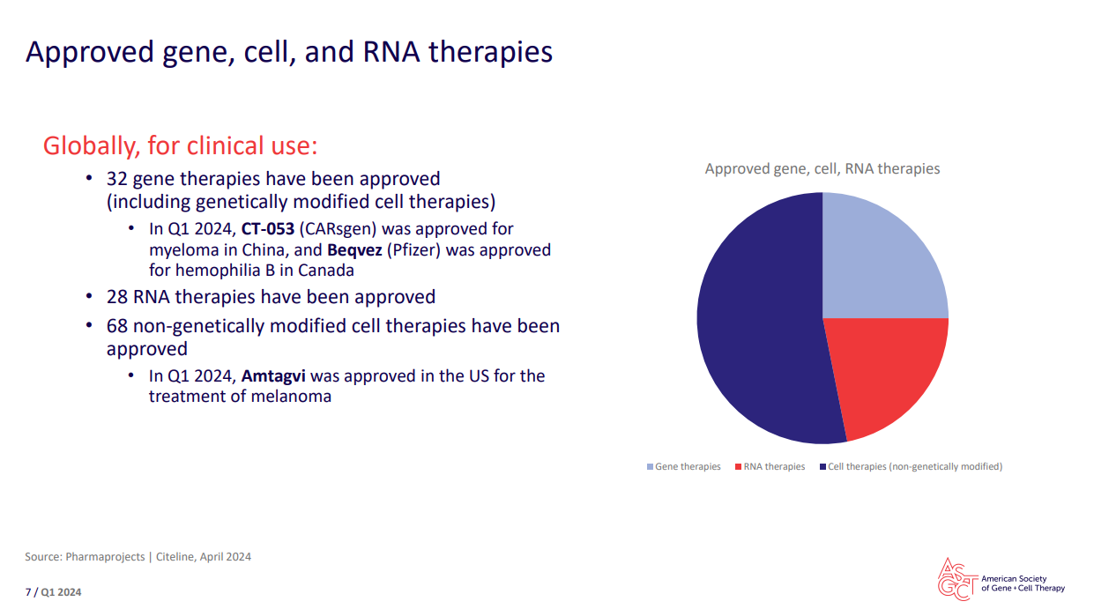

Slide 35
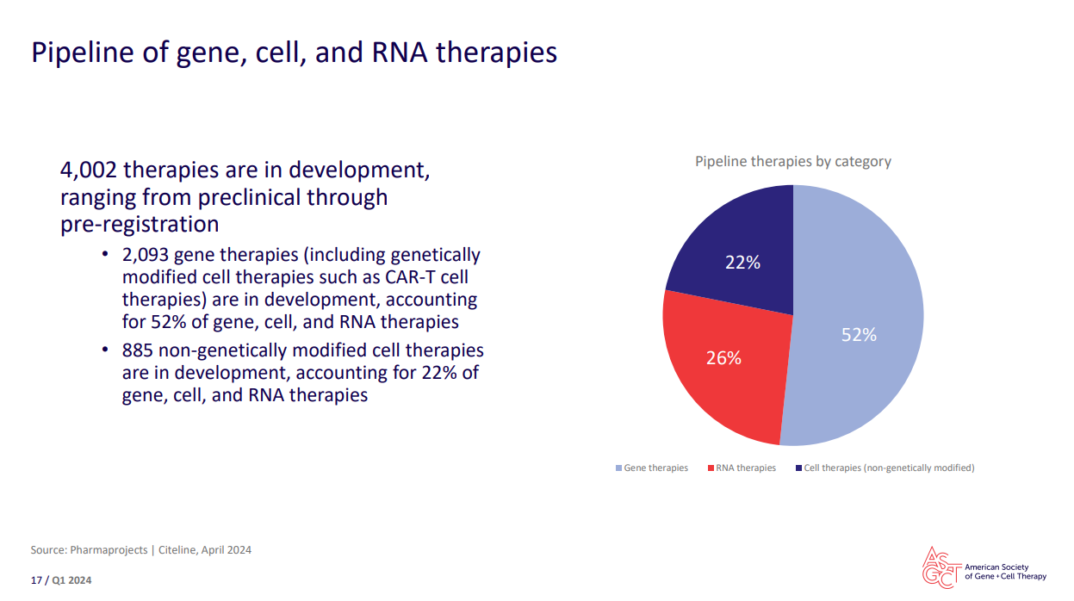

Slide 36
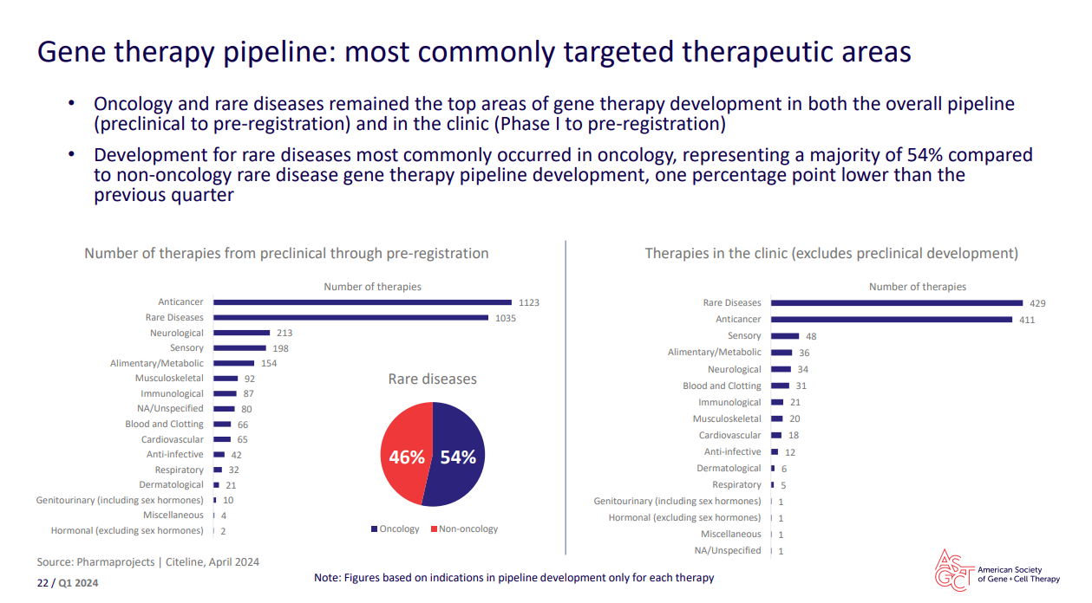

Slide 37
Fiduciary Pharmacy Risk Management Services
Leading Change

