Slide 1





Chronic Kidney Disease & Dialysis
Options to Mitigate High-Costs and Risks
02/06/2024
Tara Metzner
Strategic Account Executive
tmetzner@renalogic.com
v

Slide 2
Today, we’ll cover:
Renalogic Background with Unions
Chronic Kidney Disease and Treatment
Renalogic Service Overview
Questions

Slide 3



















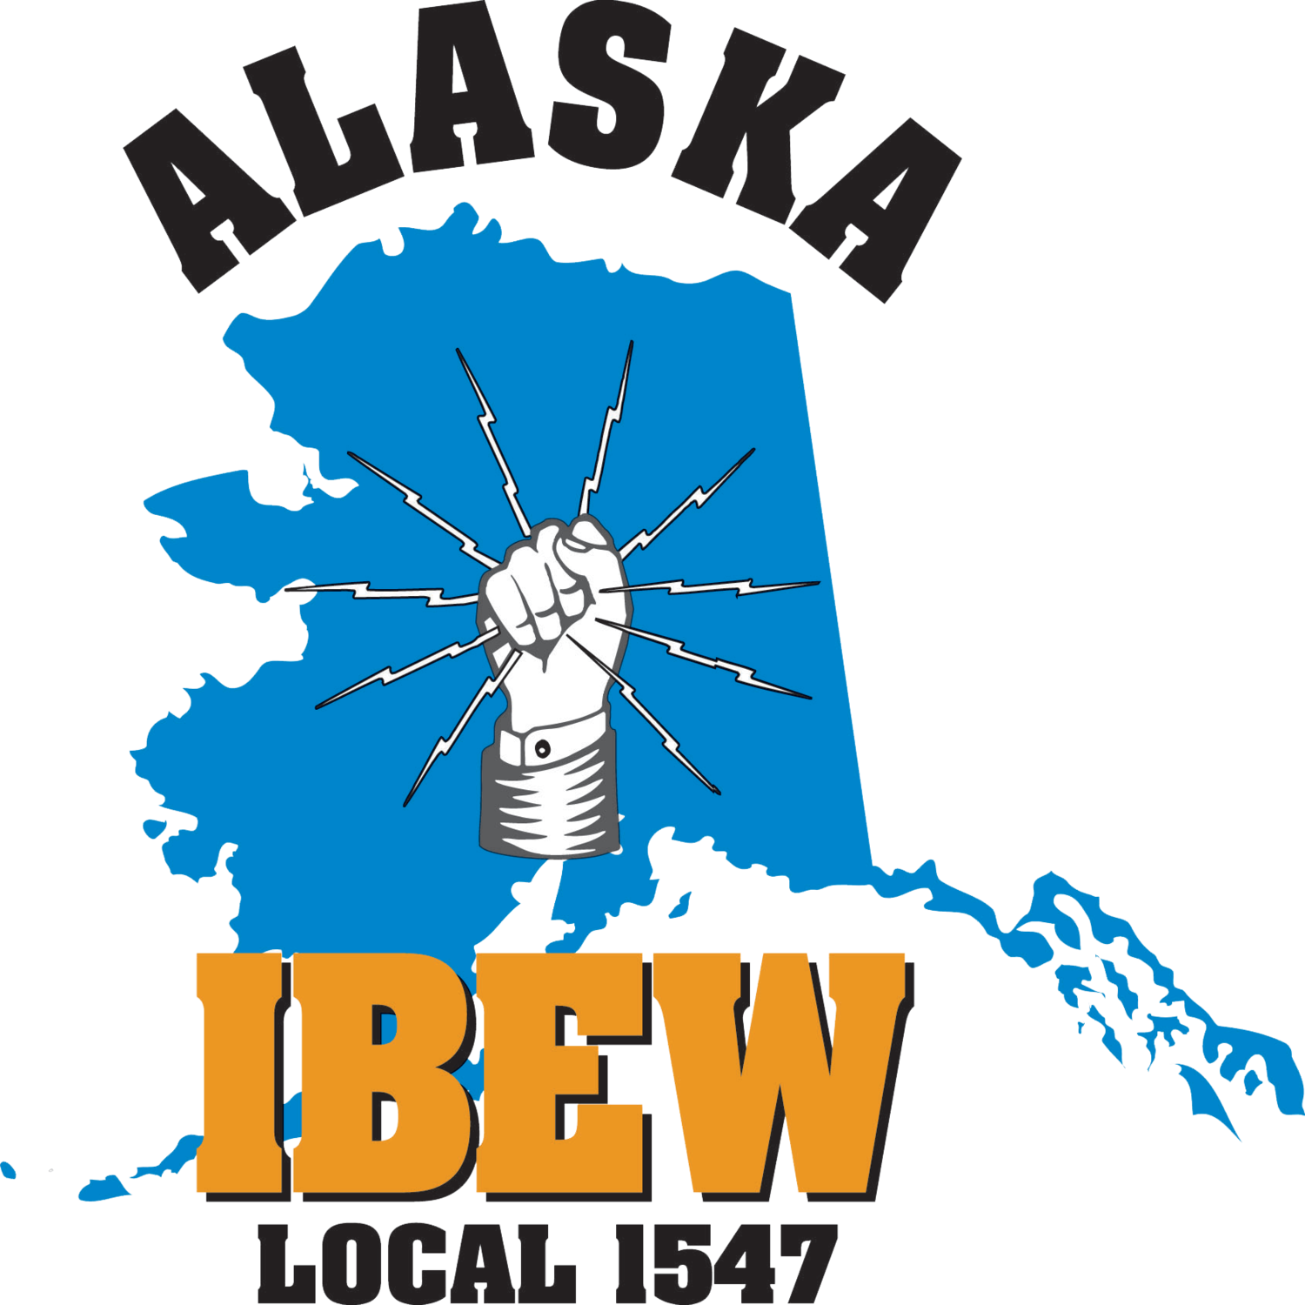
Current Fund/Union Clients

Slide 4
PHC & NLA Coalition History & Updates
2009: Started working with ASEA AFSCME Local 52 - Renalogic’s first Pacific Health Coalition (PHC) client
2014: Went through proposal and RFP with PHC - Renalogic Contract Executed
2023: Executed National Labor Alliance of Health Care Coalitions (NLA) - Renalogic Contract Executed which extends to all members of the NLA
PHC Savings since 2014 over
$100 Million on dialysis costs
With a 5:1 ROI on groups using ImpactCare

Slide 5
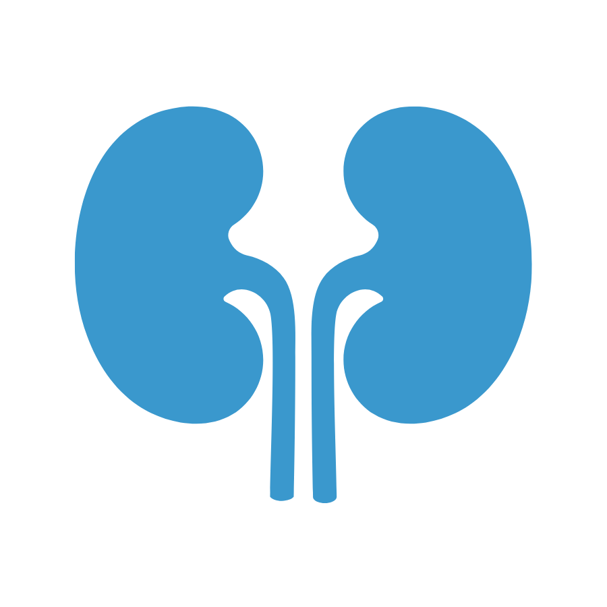
Chronic Kidney Disease – End Stage Renal Disease
Kidneys are Small but Mighty Organs
They are vitally important as they filter the toxins out of our body that we ingest.
A disease of one’s kidneys that causes the kidneys to no longer function properly. They are unable to filter the toxins out of one’s body like normal healthy kidneys.

Slide 6
Top 2 Drivers of Chronic Kidney Disease (CKD)
Diabetes
1 in 3 diabetics have CKD
Hypertension
1 in 5 hypertensives have CKD

Slide 7
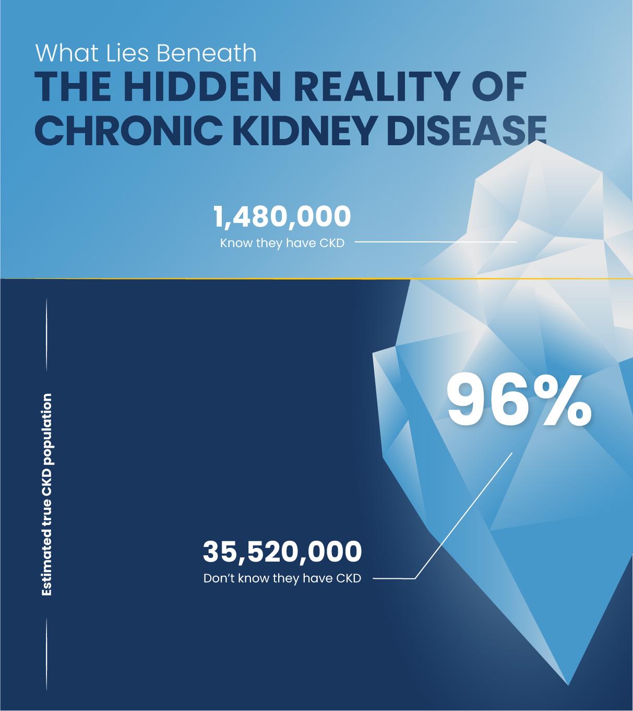
CKD Statistics,
With CKD, It’s Not A Question Of If, But Of When
37 million Americans (1 in 7) are estimated to have CKD (CDC.gov)
96 percent of people with kidney damage or mildly reduced kidney function don’t know they have it
48 percent of people with late-stage CKD are unaware they have it
80 percent of all people who start dialysis do so emergently

Slide 8
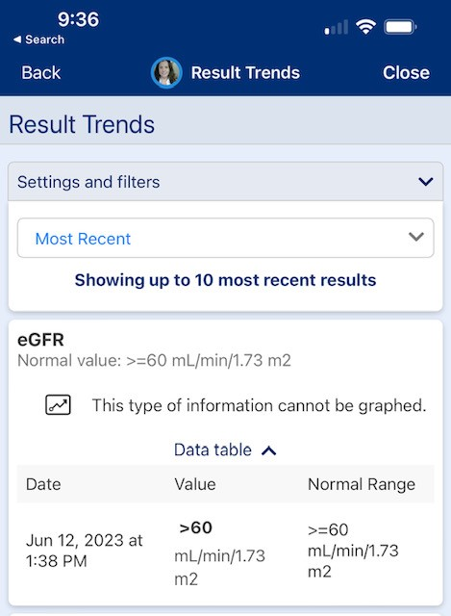
eGFR Test
Blood tests are used to determine your eGFR – Glomerular Filtration Rate – rate at which your kidney is functioning

Slide 9
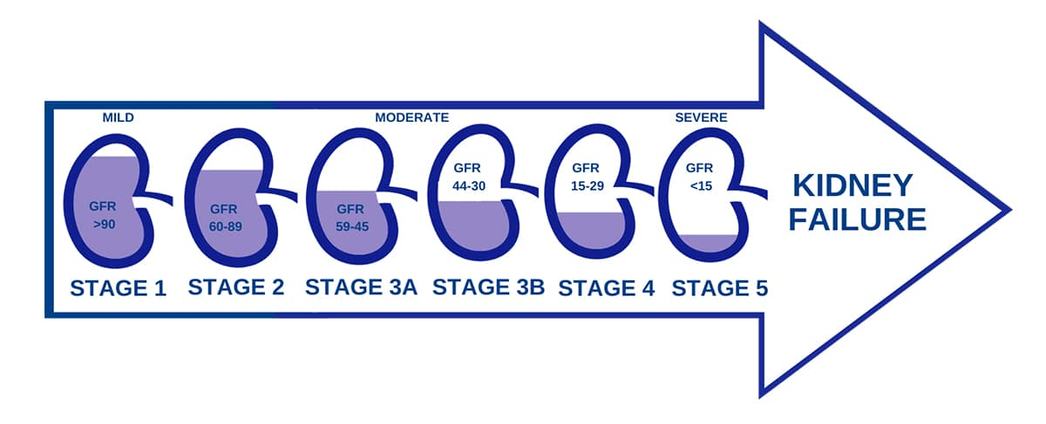
CKD Stages
CKD Stages
ESRD =
End Stage Renal Disease

Slide 10
Medicare Coverage for End Stage Renal Disease (ESRD)
Medicare part A at no cost covers:
Inpatient care
Skilled nursing
Hospice
Home health
Transplants
Medicare part B is at a monthly premium covers:
(standard premium in 2022 was $170.10 Per month)
Doctor visits
Outpatient care
DME
Preventative care
Home health
Medicare part D is drug coverage and covers immunosuppressant drugs not provided in hospital
Coordination of Benefits period: 30/33 months depending on where one starts dialysis:
30 months from start of at home dialysis –
Commercial plan is primary/Medicare is secondary, after 30 months Medicare becomes primary
33 months from start of in center dialysis –
Commercial plan is primary/Medicare is secondary, after 33 months Medicare becomes primary
3 month waiting period for Medicare assignment when members starts dialysis in center

Slide 11
There is no cure…
But there are treatment options for people with ESRD

Slide 12
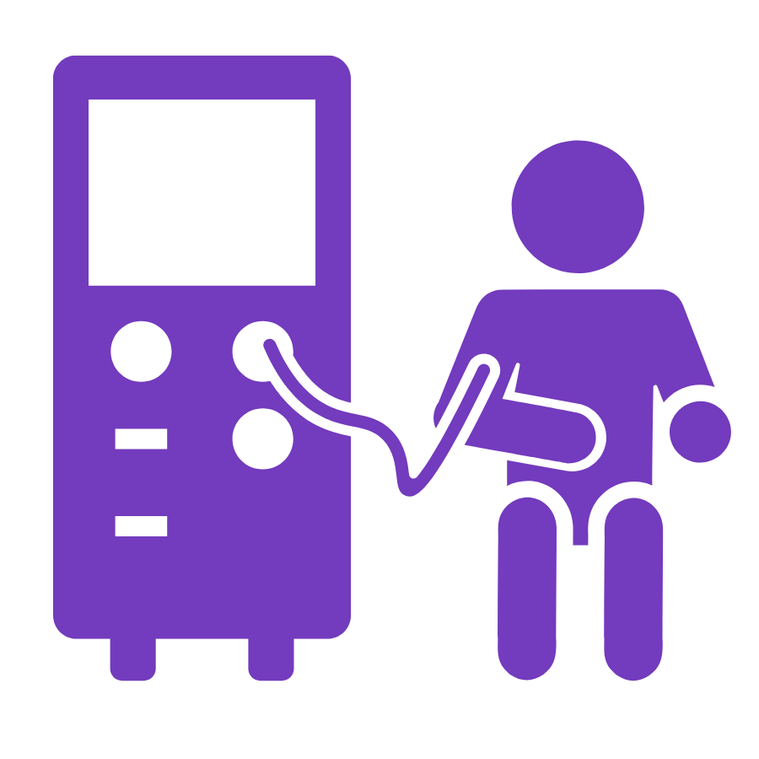
At-home
Peritoneal Dialysis (PD)
13.3%* of ESRD members receive dialysis at home
PD requires an abdominal catheter which allows the filtration to be a regular and paced schedule typically at night while one sleeps
Minimal restrictions for diet and lifestyle activities
Less missed work or daily activities
*https://usrds-adr.niddk.nih.gov/2022/end-stage-renal-disease/2-home-dialysis

Slide 13
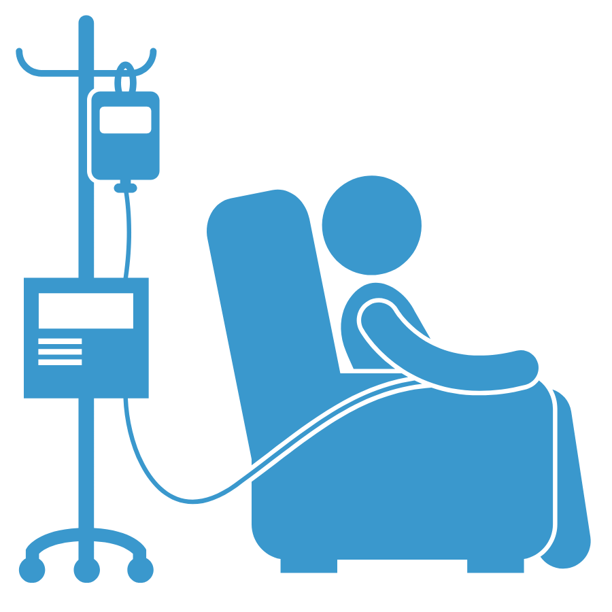
At-home
Hemodialysis (HHD)
13.3%* of ESRD members receive dialysis at home
HHD requires assistance from a caregiver 5-6 times a week.
HHD requires AVF (arteriovenous fistula) access into an artery and a vein –typically in wrist or arm for needle access
Minimal restrictions for diet and lifestyle activities
Less missed work or daily activities

Slide 14
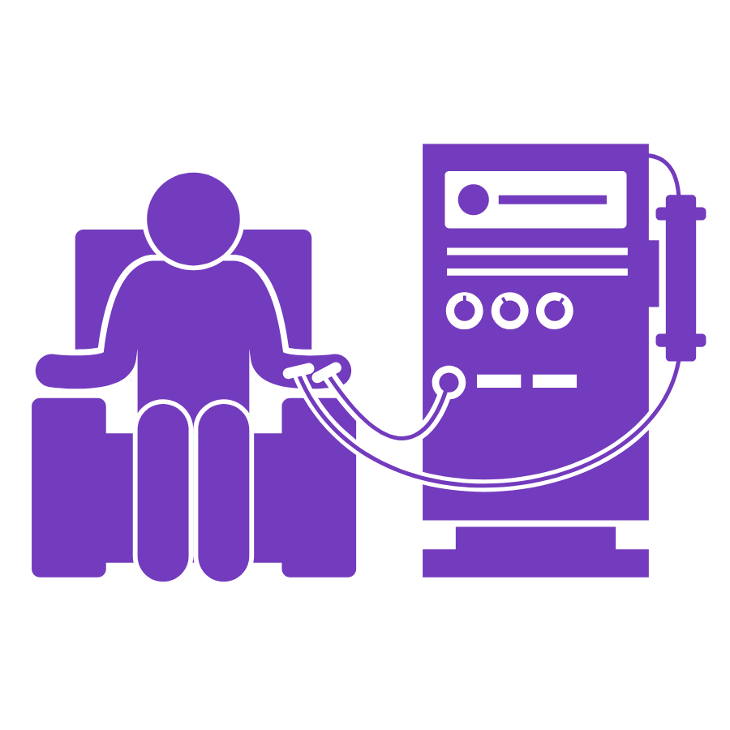
In-center
Hemodialysis
55%* of ESRD members receive dialysis at in-center facility
HD requires a person to go to the center 3-4 times a week on average for a minimum of 3 hours per trip
HD requires AVF (arteriovenous fistula) access into an artery and a vein –typically in wrist or arm for needle access
Very restrictive diet
Missed work
Missed life activities

Slide 15
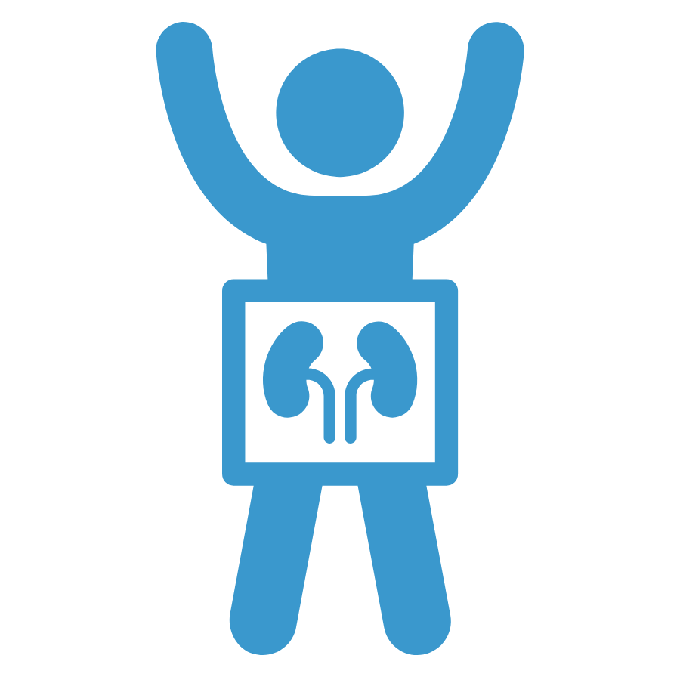
Kidney Transplantation
31%* of ESRD members are currently living with a kidney transplant
Closest treatment to a cure
Provides a higher quality of life for the individual and family
Huge cost savings to the Plan – average cost $442,500**
Shortage of organs available, need more living donor options
As of Feb. 2023, 88,658 people on the transplant list for a cadaver kidney – 25,499 kidney transplants occurred last year* to put that in perspective
*https://www.niddk.nih.gov/health-information/health-statistics/kidney-disease **https://www.ncbi.nlm.nih.gov/pmc/articles/PMC8785833/#:~:text=Kidney%20Transplantation%20Costs,was%20US%24442%2C500%20(6).

Slide 16
With early detection and proper management, people with CKD can lower their risk of ESRD and avoid the need for dialysis or transplant altogether.

Slide 17
CKD Stages
CKD Stages
ESRD =
End Stage Renal Disease
Ideal identification for early interventions

Slide 18

Living with CKD
Diet and lifestyle changes in positive healthy ways
Medication compliance
Controlled diabetes/hypertension
Stop smoking
Reduce alcohol intake
Reduce nephrotoxic medications
Increase physical activity
Work with a dietician/health coach/care manager

Slide 19
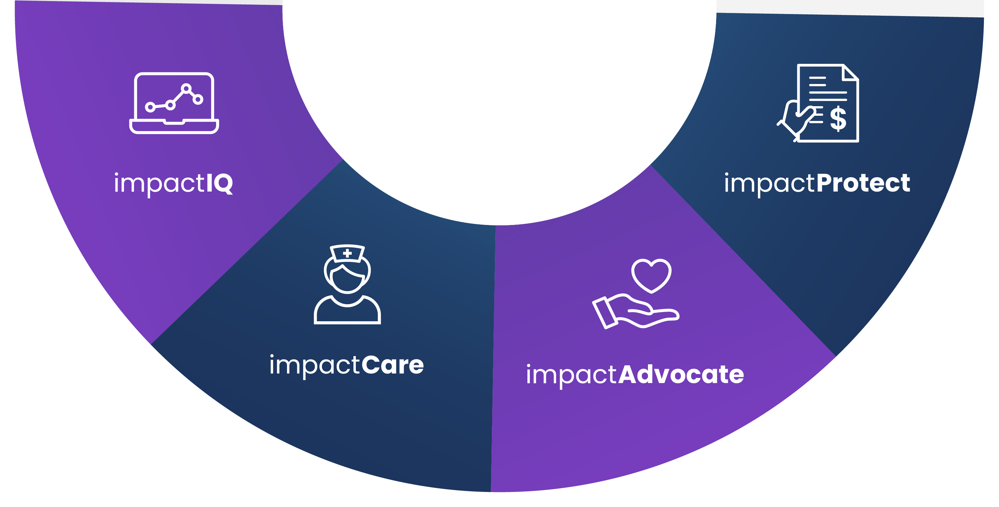
How We Do It
Identify hidden CKD risk and what is driving increased spend through algorithmic claims analysis
Reduce catastrophic claim costs for members on through proprietary dialysis repricing programs
Early, specialized clinical intervention to reduce improve member overall health, risk to avoid dialysis all together
Ensure a non-emergent start for members who begin dialysis by navigating members to lower cost, high-quality treatments

Slide 20





Option 1
Proactively Contain Costs
and Eliminate Future Risks
Option 2
Recalibrate and Reduce
Extreme Dialysis Claims
Option 3
Proactively Manage CKD
and Reduce CKD Risks

Slide 21
QUESTIONS?

Slide 22
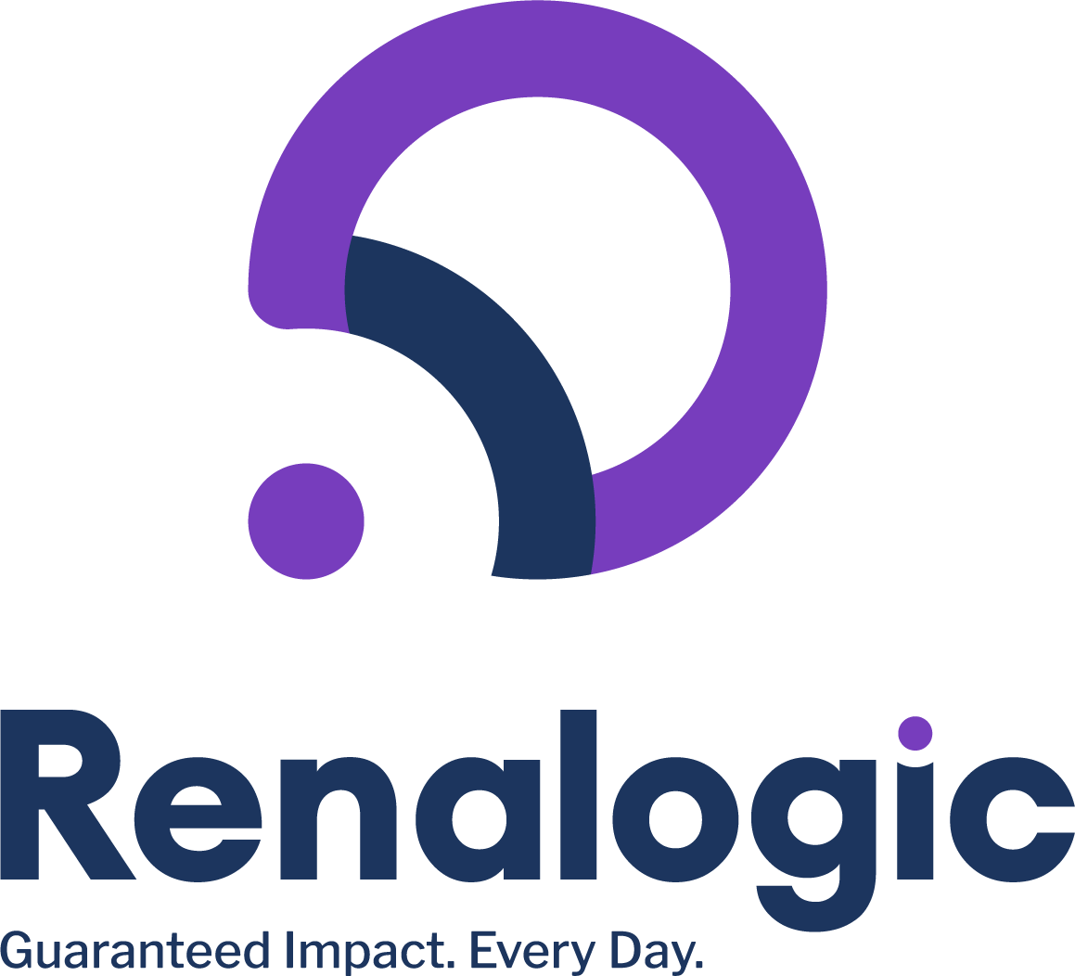
Thank you for your time!
Tara Metzner
Strategic Account Executive
tmetzner@renalogic.com

