Slide 1
Comparative Effectiveness Research: A Positive Impact on Formularies
Informed decisions will lead to better outcomes.

Slide 2
Agenda
The Current Approach to Formularies and Challenges
Introduction to Open Architecture allowing for Collaboration
About Comparative Effectiveness Research (CER)
Group Analysis
Implementation

Slide 3

Current Challenges When Choosing a Formulary
1
3
Pricing Over Efficacy
  Formularies prioritize drugs
  with higher rebates over
  patient outcomes.
Artificial Pricing & Rebates
  Inflated drug prices are
  driven by rebate opportunities,
  not real savings.
Misaligned Incentives
  Is your provider aligned with YOUR goals? Are they leaving no stone unturned? Will they allow integration of independent solutions?
Lack of Transparency
  Transparency should not be a “catch phrase” but expected. Honesty is paramount when it comes to healthcare.
2
4

Slide 4




Open Architecture
A Philosophy of Complete Customization
An “open-architecture” approach to plan design and management means empowering you to have a say in your plan components. You choose the vendors and cost-containment tools, so you can choose the elements that work best for your needs, and nothing that doesn’t.
You take control of your costs and truly understand the benefits you’re paying for.
Flexible
Plan Design
Customizable
Formularies
Control of
Rx Spend
Greater
Savings

Slide 5
Comparative Effectiveness
Research (CER)
About
What is CER?
Comparative Effectiveness Research is evidence-based research with a patient-centered approach created with the intention of providing data on the effectiveness of various treatments to make informed healthcare decisions.
Most people today are not taking prescription medicines because they want to but rather need to.
The Goal: Better Care & Lower Costs
CER identifies the most effective drugs
through human interactions and ensures they are
delivered at the lowest possible cost for
patients and providers, improving both
outcomes and affordability.

Slide 6
How efficacy is defined at FDA
“FDA-approved”
A drug must show statistically significant
difference on a primary outcome
compared to placebo

Slide 7

FDA does not require new drugs to be better than existing drugs
“New and approved”
“New and improved”

Slide 8
FDA does not require new drugs to be better than existing drugs
73%

Slide 9

With so many options, how do you choose?
As newly approved drugs flood the market, how can we assess the competitive value of different treatment options?

Slide 10
Comparative effectiveness research (CER) is the highest quality clinical research available
“Is the drug better than the placebo?”
WEAK
“Is the drug better than other drugs?
STRONG

Slide 11
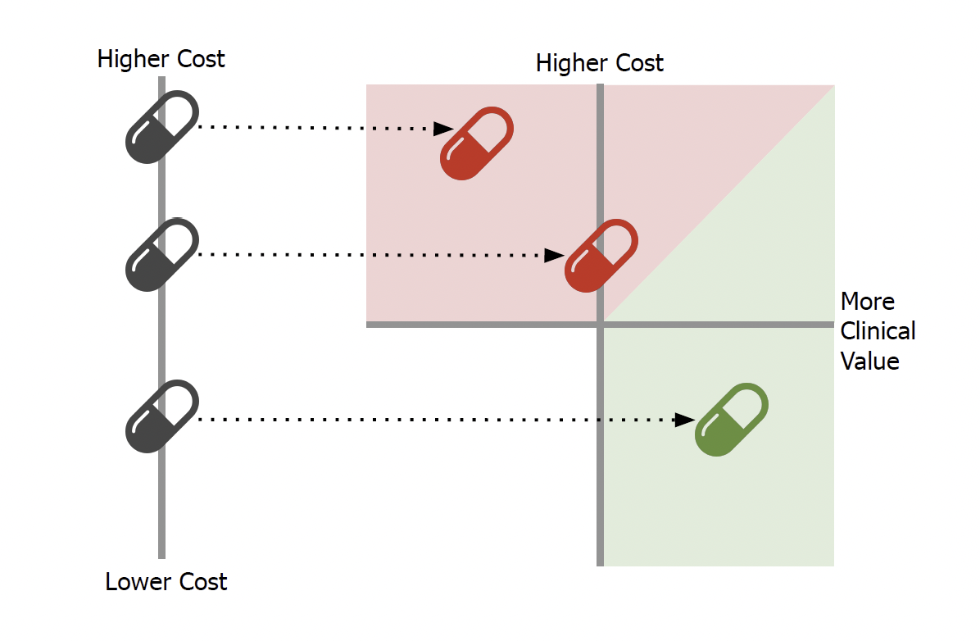
CER gives you another dimension of value

Slide 12
Comparative Effectiveness Research
Brief History
About
History of CER
CER can be traced back to the mid 18th century with James Lind and the study of Scurvy. This is considered the first example of comparing various treatments and finding which was most effective.
In the early 20th Century, a surgeon named Ernest Codman pushed for the concept of “outcomes management which provided a blueprint to modernizing CER practices.
Later in the mid-20th Century the methodologies used to determine CER were refined, allowing for more intense comparisons between treatments.
In the 1990’s the Cochrane Collaboration was formed. This is a not-for-profit organization that today collaborates with researchers, health professionals, patients and caregivers from 190 countries. Their expansive independent network allows them to compile, compare and determine “best practices”.
Currently, the US Government funds several organizations or agencies:
-The Agency for Healthcare Research and Quality (AHRQ)
-The National Institute of Health (NIH)
-The Patient-Centered Outcomes Research Institute (PCORI)

Slide 13

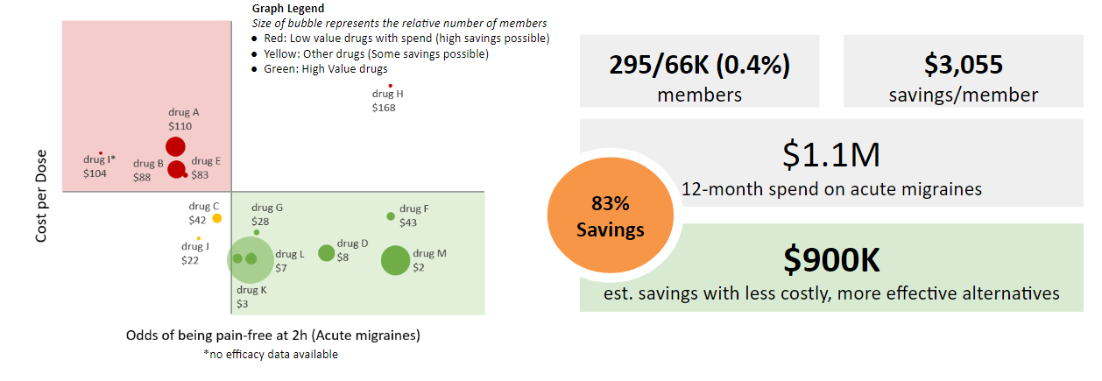
Review Pharma Savings Others Miss
Comparative Effectiveness research answers the question: what’s the best option?
  Comparative effectiveness research shines a light and shows us exactly where we are getting great value, and where we are paying too much and getting too little. Below is a comparative effectiveness chart for migraine medications. Through research we can see that the red medications are low value drugs because they have a higher cost and lower effectiveness. The green drugs are would be considered high value drugs because of their increased effectiveness and additional low cost.

Slide 14
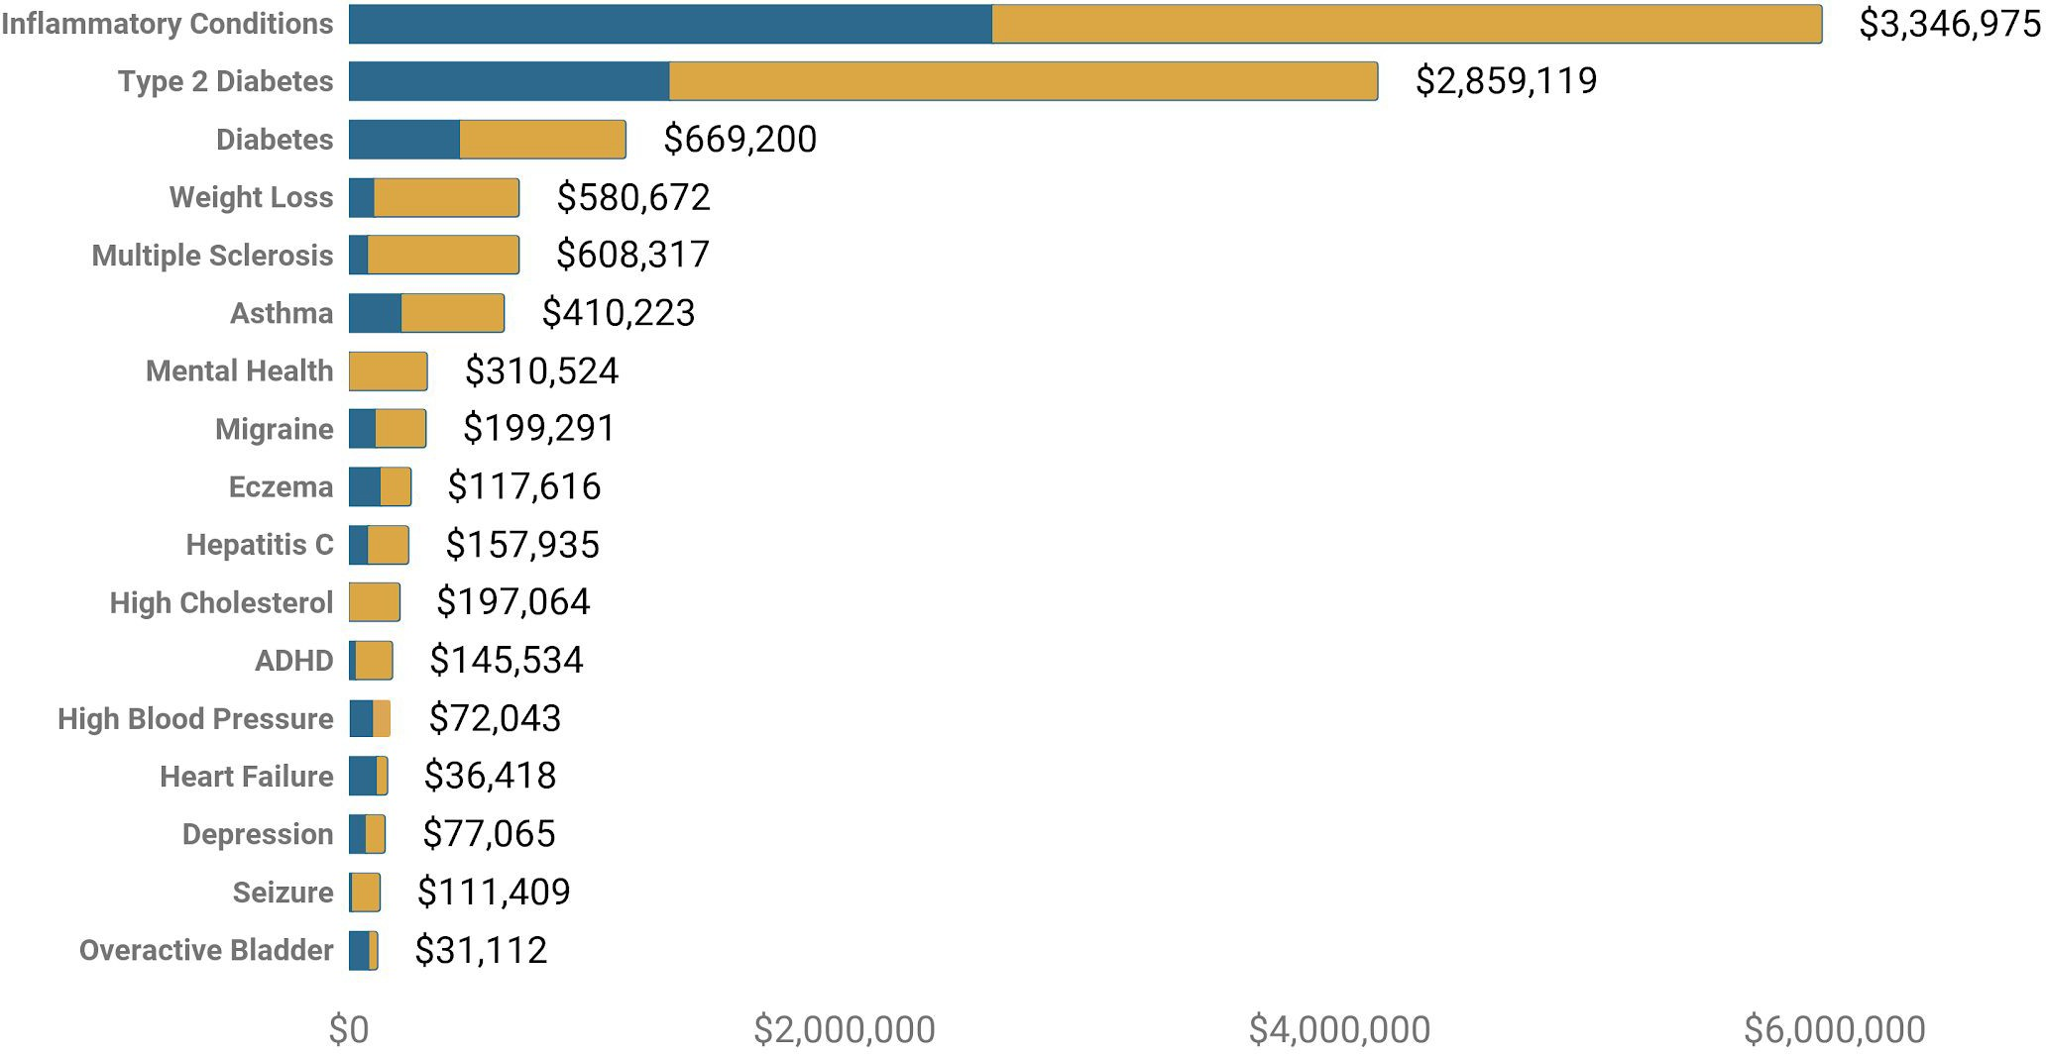
$10.8M clinically-based savings opportunities, by condition
Proposed savings
Proposed spend

Slide 15
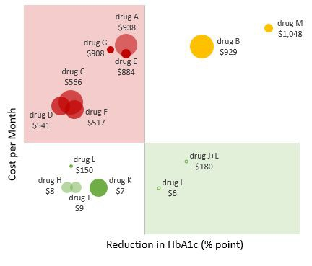
Savings in Brands: Why FDA approval is a weak standard and comparative effectiveness is better
Clinical Insight: Diabetes is a huge area of spend with opportunity for CER-based utilization management. The savings calculation assumes a 70% conversion rate when switching from one class to another based on actual client experience switches within class
Graph Legend
Bubble size represents relative utilization. Outlined bubble represents no utilization.
Red: Low value drugs with spend (high savings possible)
Yellow: High Cost medications (some savings possible)
Green: High Value medications
300/14,504 (2%)
Affect ed members
$9.3K
savings/member
$4.4M
12-month spend on Type 2 Diabetes
65%
Savings
$2.8M
est. savings with higher value alternatives

Slide 16



Comparative Effectiveness Research (CER)
The Benefits of
Significant
Savings
Improved
Outcomes
Evidence-Based
Strategies

Slide 17

Efficient Implementation
Worried about member disruption and change? The flexible approach makes it easy to get your plan up and running with minimal disruption. Unions can offer several solutions to allow for notifications of members for formulary changes, and even work with a period of grandfathering to allow members to work with their doctors to find the appropriately covered medication. It is not unusual for some plans to allow a 60-day grandfathering period, but keep in mind any grandfathering period will reduce immediate savings.
We will communicate directly with the effected members and their physicians to help ensure a smooth changeover. If members have questions, our clinical team is here to answer them. You can rest assured that our strategy is to make this process as smooth and seamless as we possibly can.

Slide 18

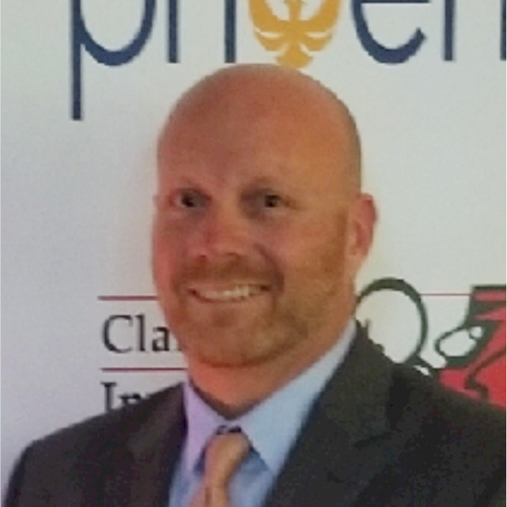

CER Helps Phoenix
Be the Champion of
Maximizing Savings
Questions?
Scan for More Info
Greg Herbstman
Director National Labor Relations
greg.herbstman@phoenixpbm.com
732.995.1717
Levi Roseman
TruDataRx, Regional Sales Director
levi@trudatarx.com
814-648-3494

