Slide 1

Enhancing Member Engagement and Reducing Confusion in Self-Funded Health Plans through Integrated Solutions
Presented by: David Lauritzen / Conifer Health
Date: February 4, 2025

Slide 2

Welcome

Slide 3





Introduction
Continued increases of episodic care and chronic conditions in healthcare, which leads to increased risk and higher costs of care.
Healthcare industry is evolving with the rise of point solutions and digital health tools to address chronic conditions.
Member engagement with medical management (UM,CM,DM) is crucial to address health risks in improving outcomes and reducing costs.
Member confusion, duplication of services, and barriers to engagement persist with unintegrated solutions and services.
Data alone can identify potential risks in a health plan, but meaningful engagement with at risk members is crucial to translate those insights into actionable changes that significantly reduce costs and improve patient outcomes.
Better integration is needed with medical management and point solutions to provide better engagement and navigation of resources, especially with higher risk members.

Slide 4






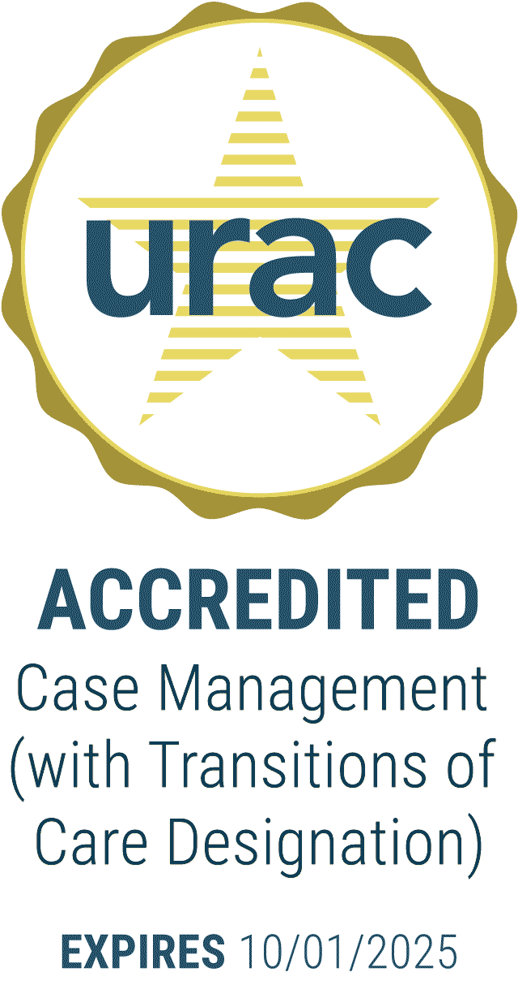
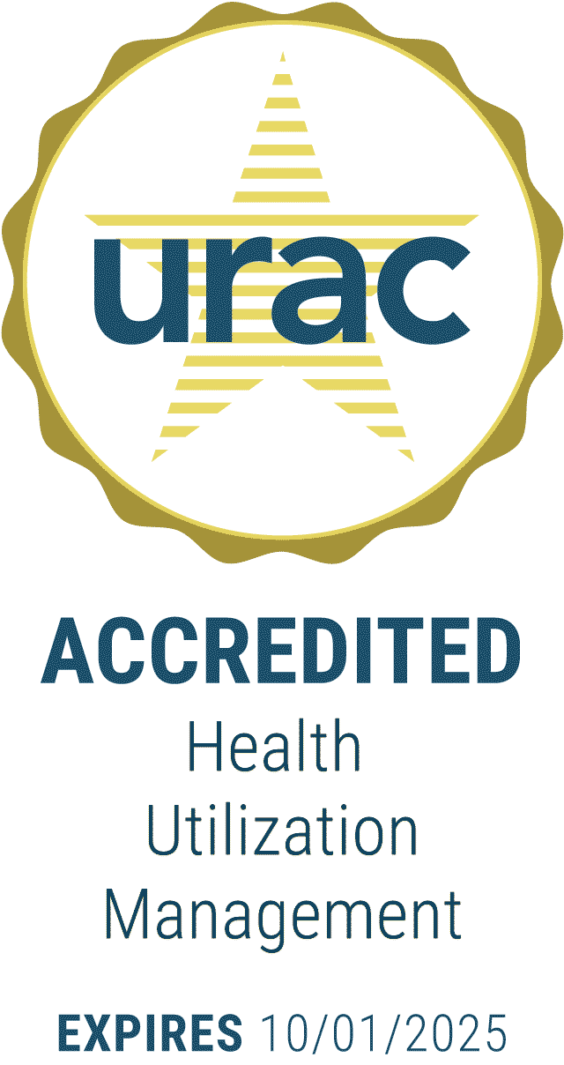
Conifer Health | At-A-Glance
35⁺
Years of experience
215⁺
Clients
(employers, unions & health plans)
>1M
Members served by our care management programs
50
States with active members
Diverse Partners
Accreditations

Slide 5



Population Health Management Overview
Lower the Cost of Care, Improve Health Outcomes, Provide Exceptional Member Experiences
98%
Member Satisfaction
88%
Member Engagement
Utilization Management
Case Management
Personal Health Management
70%
Move into self-management
Maximize member access to the right care, in the right setting, at the right time
In-depth understanding of your organization’s benefit plan
Support for acute episodes with post-episode coordination
Dedicated Personal Health Nurse
Transitions of Care
Proactive outreach based on risk stratification
Chronic and acute conditions plus health behaviors
Dedicated Personal Health Nurse for 1:1 collaboration & care/goal planning
3:1
Return on Investment
≥98%
Turnaround Time

Slide 6



Taft-Hartley Experience
Focus since 2015
Representative Clients
800K⁺
Taft-Hartley members
25⁺
Years serving Taft-Hartley plans
Conifer Team Members Supporting Taft-Hartley Clients:
95 Personal Health and Utilization Management Nurses
9 Nurse Managers
3 Clinical Directors
3 Focused Account Managers
2 Executive Leaders

Slide 7




What is Member Engagement?
The process of actively involving healthcare members in their own health and wellness that leads to better health outcomes, cost savings and member satisfaction.
Active Participation
Adherence to Clinical Guidelines
Education and Empowerment
Communication
Personal Responsibility

Slide 8
Challenges in Member Engagement
Lack of Understanding Members may not fully understand their benefits or healthcare options
Denial of Current or Future Conditions Member may deny having a condition or have a need for engagement and outreach
Technology Barriers Older populations or those without tech access may struggle to engage
Overwhelming Information Too many solutions or communications can overwhelm members

Slide 9

What Are Point Solutions in Healthcare?
Specialized clinical and digital tools or services designed to address specific healthcare needs (e.g., mental health, cancer, MSK, CKD, Diabetes, etc.)

Slide 10
Challenges with Unintegrated Solutions
Fragmentation Multiple, disconnected point solutions often lead to fragmented care
Overwhelming Choices Members may be unsure which solutions to use, leading to decision fatigue
Integration Issues Lack of integration between point solutions and existing healthcare systems and medical management (e.g., utilization management, case management) creates duplication, confusion and inefficiency
Complex Navigation Difficulty in understanding which solutions best meet personal health needs

Slide 11





Overall Impact of Unintegrated Solutions and Poor Member Engagement
LOWER HEALTH OUTCOMES
Disengagement and lack of proper use of tools lead to suboptimal health outcomes.
INCREASED HEALTHCARE COSTS
Inefficiencies and duplicated services due to confusion.
MEMBER FRUSTRATION
Poor experiences result in members abandoning tools and programs.
UNDERUTILIZATION OF AVAILABLE SOLUTIONS
Failure to maximize the potential of healthcare services and technology available.

Slide 12

Path Forward

Slide 13



Path Forward
Whole Person Approach
Focus on member and all of their needs to better engage and ensure they have the resources they need.
Benefit Solution Integration
In conjunction with medical management, all health plan solutions should be integrated to work together to reduce confusion and provide better navigation.
Communication and Marketing
Tailor and customize member communication to increase awareness of resources to improve engagement and health literacy overall.
1
2
3

Slide 14





Nurses Understand the Whole Person
Advocating for Their Healthcare Needs
Psychological
Anxiety, Attitude, Depression & Stress
Hospital Case Manager
Behavioral
Lifestyle, Nutrition, Smoking & Values
Onsite/near-site Clinics
Behavioral Health
Demographical
Domestic Status, Economic Status, Education & Employment
DME
Pharmacy
Manager
Societal
Family Assistance, Access to Care, Literacy, Public Safety & Transportation
Community Programs

Slide 15




Integration with Benefit Vendor Partners
Coordination with Other Benefit Vendors is a Consistent Strength and Key Focus
Examples of Benefit Vendors Conifer Coordinates with:
Best Practices Conifer Deploys Based on Client’s Desires:
Full review of benefit offering including changes annually
Development of hand-offs/referrals to other benefit vendors
Monthly “Grand Rounds” to discuss complex members and ensure hand-offs work as expected
Annual vendor summit to understand scope and role of each vendor and review collaboration
Member education of benefit program(s) that would be beneficial for member, e.g., telemedicine, behavioral health
Pharmacy Benefit Manager (PBM)
Point solutions – diabetes, cancer, MSK, etc.
Maternity management
Onsite/near-site clinic
Behavioral health
Wellness
Telemedicine

Slide 16

Conclusion

Slide 17
Summary
Call to Action
Member confusion, duplication of services, and barriers to engagement persist with unintegrated solutions and services.
Simplification, personalization, and integration of health plan solutions with medical management are key to overcoming these issues.
A collaborative, member-focused approach will drive better outcomes and satisfaction increasing engagement.
Having an effective medical management program that can prioritize the member experience by becoming the central hub by integrating with all plan solutions will lead to better member engagement to improve outcomes and reduce future healthcare costs.

Slide 18

Q&A

Slide 19
Thank You
David A. Lauritzen
RVP of Business Development, VBC
(410) 236-8640 | david.lauritzen@coniferhealth.com

